Slide 1
Academic Operations Informations System
supervisor: Ahmed A. Al-Hammad
Hussein Layth Al-Madhachi
supervisor: Ahmed A. Al-Hammad

Slide 2
IDEA
It serves as a central hub for managing
students, teaching staff, subjects, and the complex web of academic records that connects them
The Academic Operations Information System is a comprehensive backend solution designed to streamline and digitize the core academic processes of Al-Nahrain university.

Slide 3
IDEA
The Academic Operations Information System is a comprehensive backend solution designed to streamline and digitize the core academic processes of Al-Nahrain university.
including but not limited to coursework grades management and students attendance

Slide 4
IDEA
built with a focus on data integrity and efficient administration
The Academic Operations Information System is a comprehensive backend solution designed to streamline and digitize the core academic processes of Al-Nahrain university.

Slide 5
IDEA
The Academic Operations Information System is a comprehensive backend solution designed to streamline and digitize the core academic processes of Al-Nahrain university.
the system supports various user roles including Administrators, Super Admins, and Teachers.

Slide 6
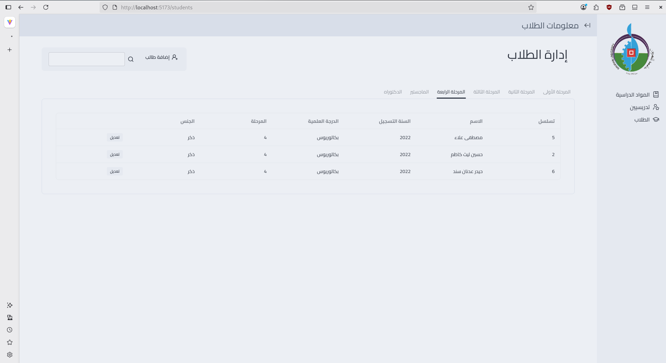

Slide 7
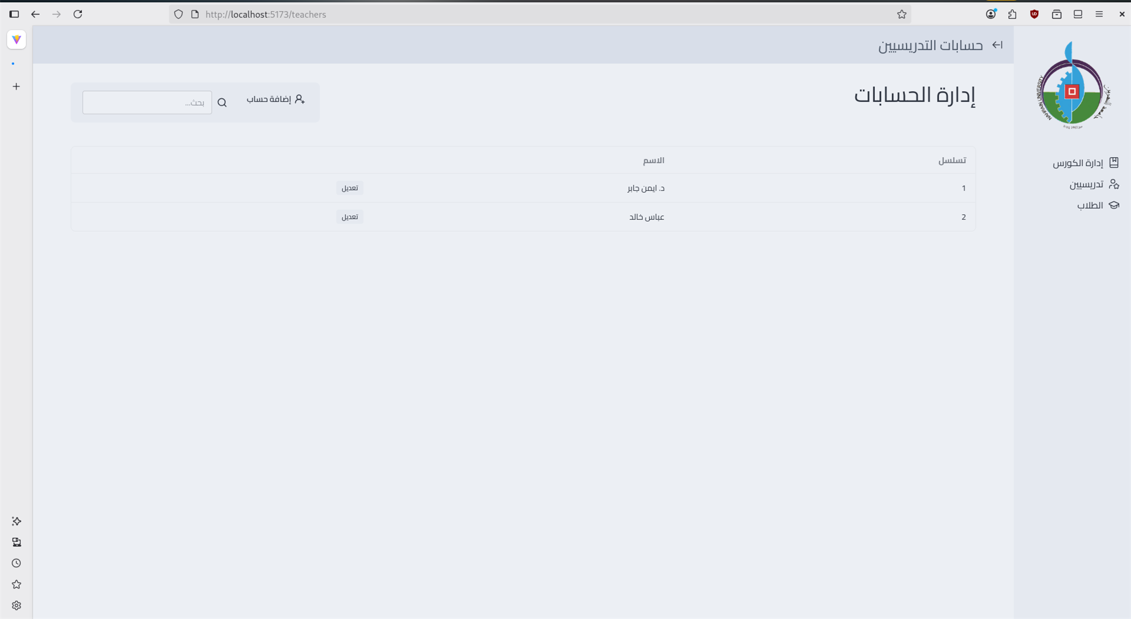

Slide 8
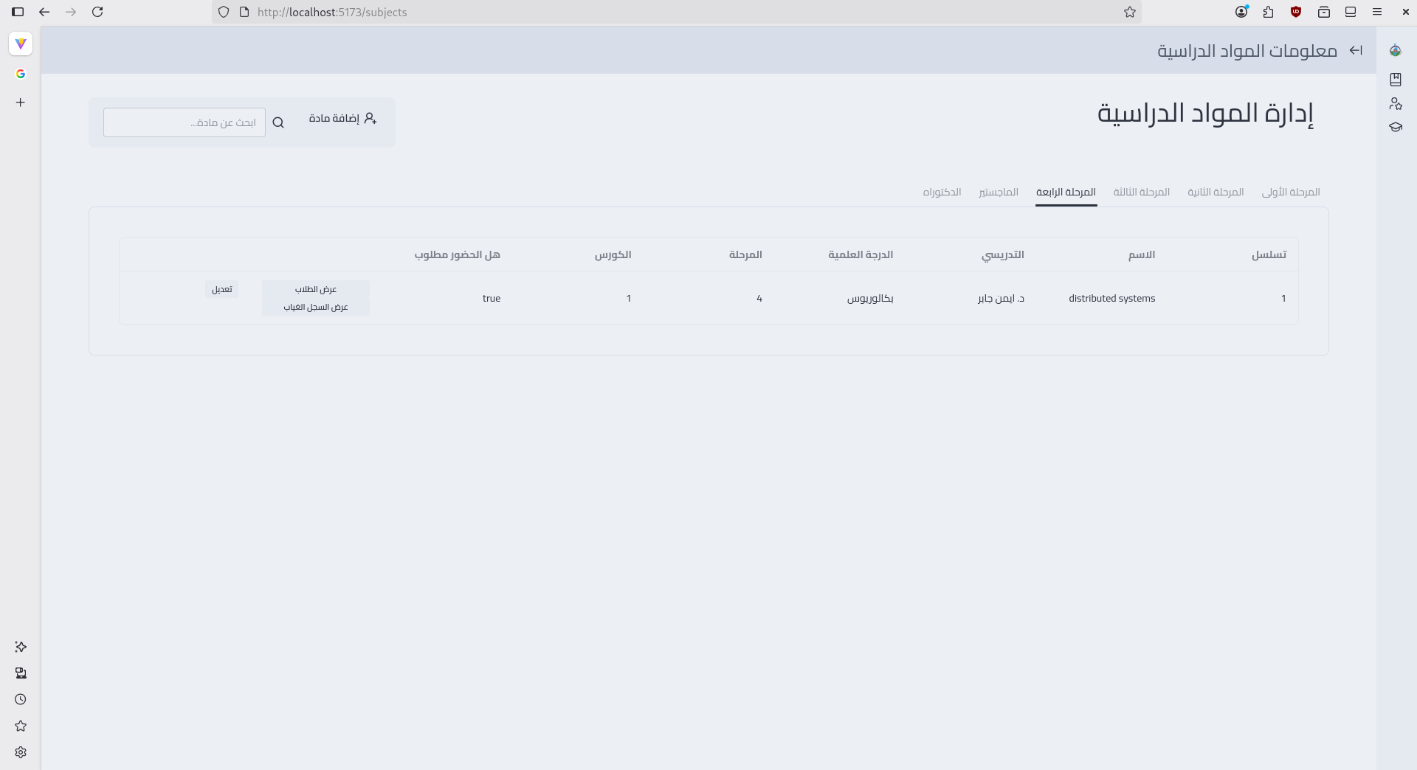

Slide 9
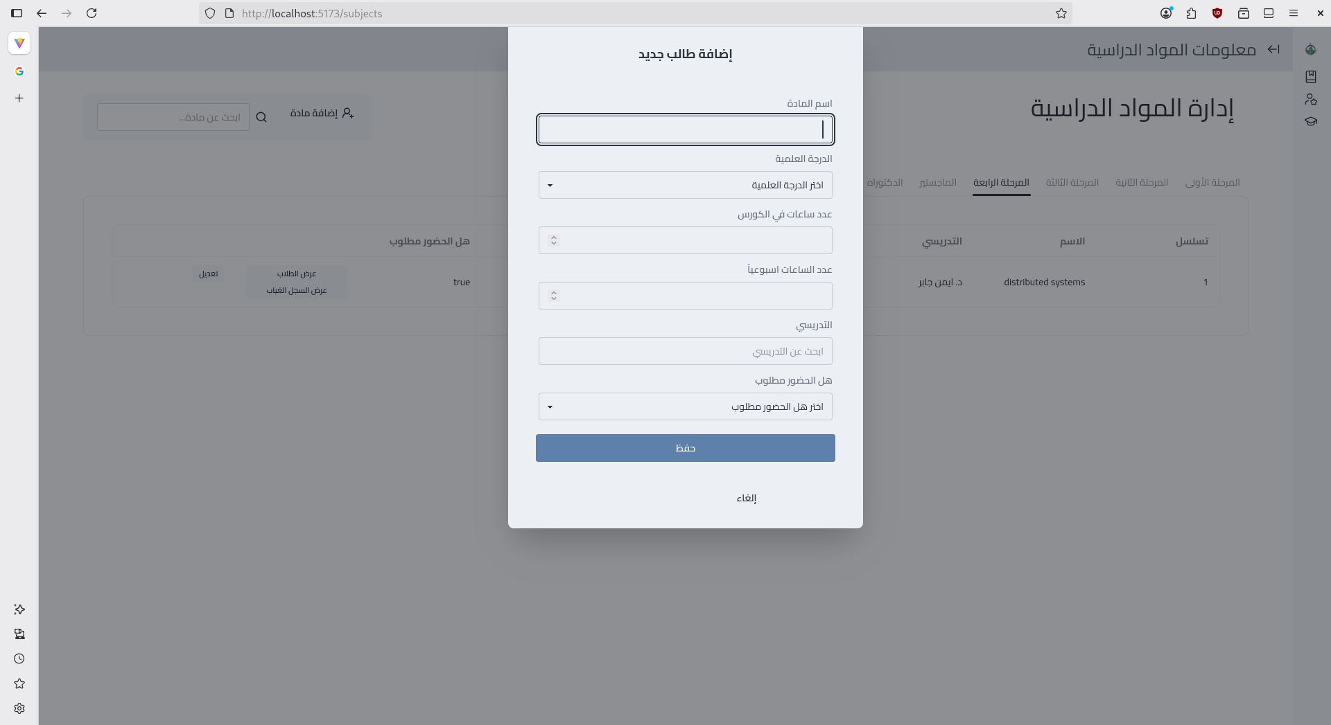

Slide 10
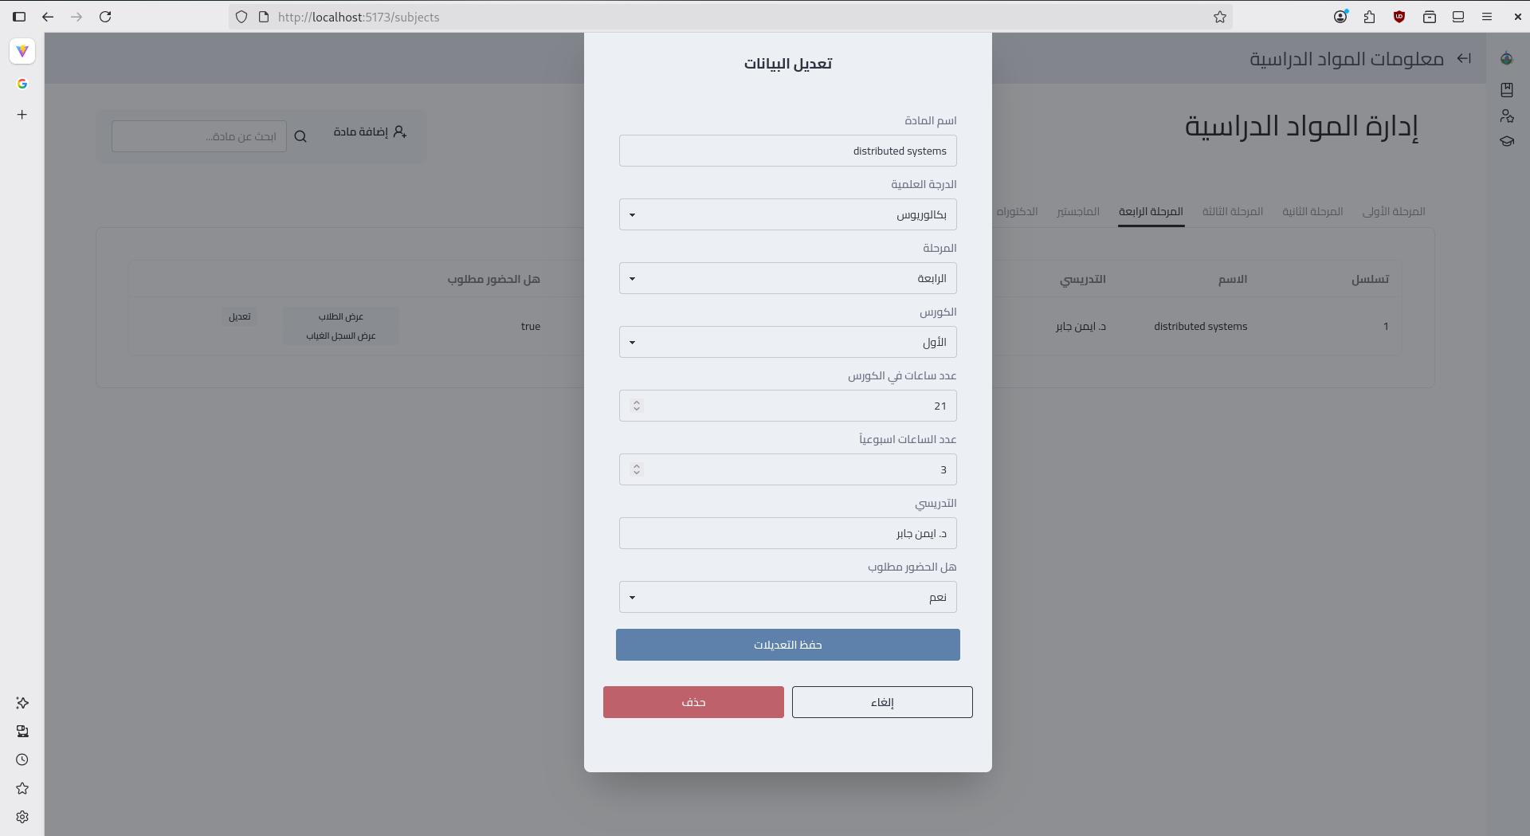

Slide 11
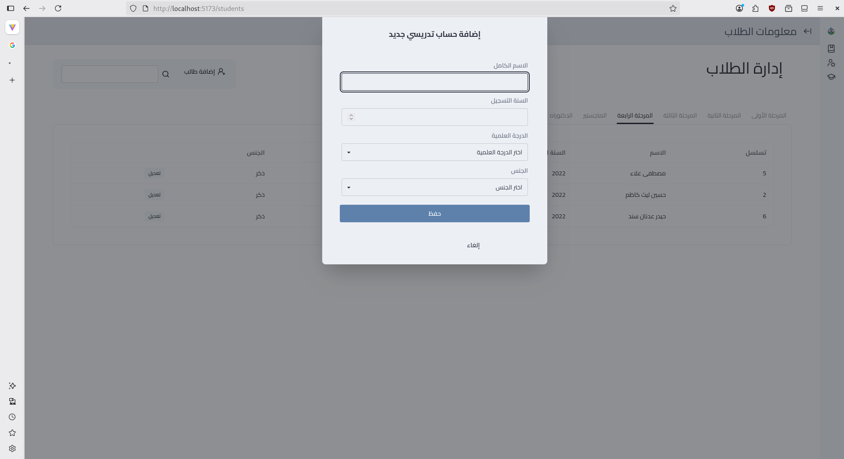

Slide 12

TECH STACK
FRONTEND
React with TypeScript for a robust, type-safe UI
Frontend Framework
Build Tool
Data Layer
Routing

Slide 13

TECH STACK
FRONTEND
Vite for high-performance development and optimized production builds
Frontend Framework
Build Tool
Data Layer
Routing

Slide 14
TECH STACK
FRONTEND
Custom RPC (Remote Procedure Call) implementation for seamless, strongly-typed backend communication
Frontend Framework
Build Tool
Data Layer
Routing

Slide 15
TECH STACK
FRONTEND
Lightweight and fast routing using 'wouter'
Frontend Framework
Build Tool
Data Layer
Routing

Slide 16
TECH STACK
BACKEND
Node.js with Express, providing a robust and scalable server environment
Implements a Remote Procedure Call (RPC) architecture using enders-sync, ensuring type-safe and efficient
Backend Framework
API Communication
Language
Written in TypeScript, ensuring code quality and maintainability through strong typing
DataBase
PostgreSQL, leveraged for its reliability and relational data integrity, utilizing pg-norm for efficient database interactions

Slide 17
TECH STACK
BACKEND
Node.js with Express, providing a robust and scalable server environment
Implements a Remote Procedure Call (RPC) architecture using enders-sync, ensuring type-safe and efficient
Backend Framework
API Communication
Language
Written in TypeScript, ensuring code quality and maintainability through strong typing
DataBase
PostgreSQL, leveraged for its reliability and relational data integrity, utilizing pg-norm for efficient database interactions

Slide 18
TECH STACK
BACKEND
Node.js with Express, providing a robust and scalable server environment
Implements a Remote Procedure Call (RPC) architecture using enders-sync, ensuring type-safe and efficient
Backend Framework
API Communication
Language
Written in TypeScript, ensuring code quality and maintainability through strong typing
DataBase
PostgreSQL, leveraged for its reliability and relational data integrity, utilizing pg-norm for efficient database interactions

Slide 19
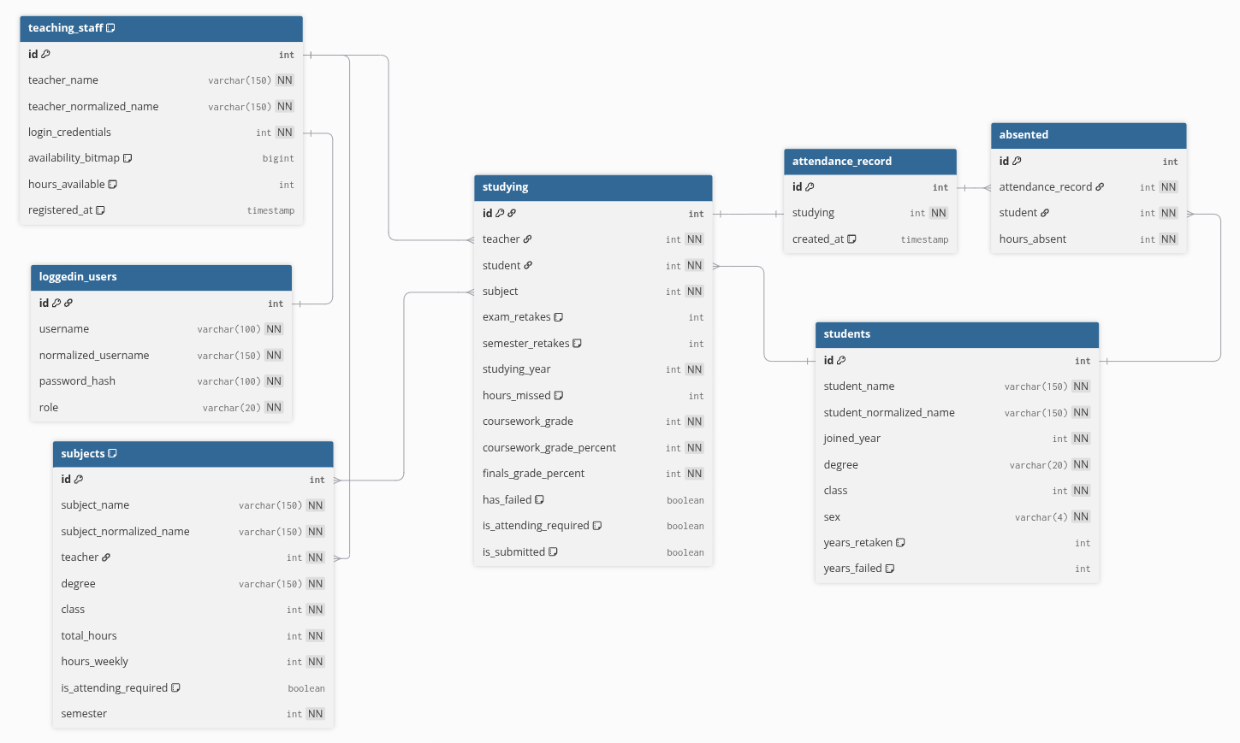
SCHEMA

Slide 20
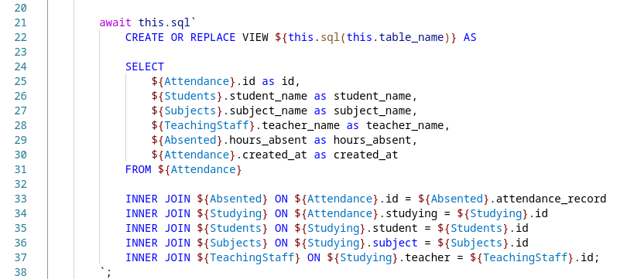
VIEWs
“Complex problems require simple solutions”
Complex Joins can be simplified in VIEWs

Slide 21
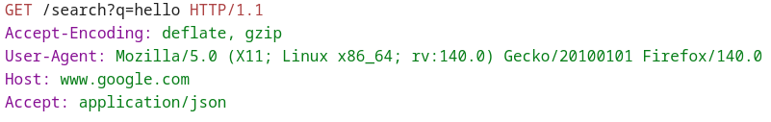
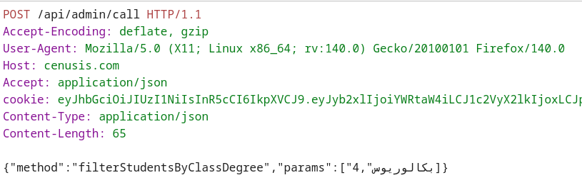
HTTP: the protocol of almost everything
Plaintext TCP based protocol used on nearly all online systems in existence

Slide 22
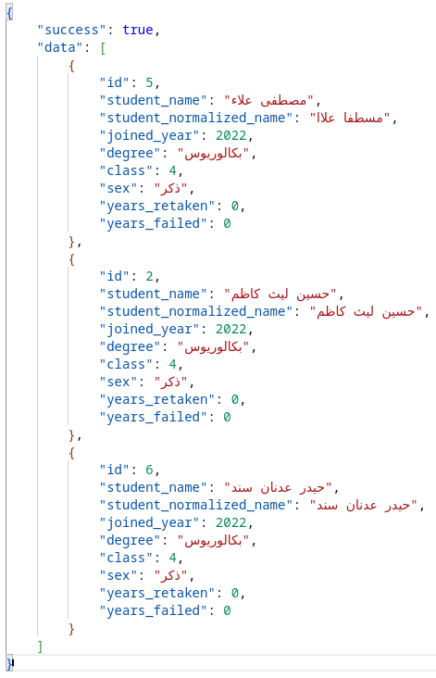
JSON
A way to represent data and transmit it
Used primarily to communicate over HTTP

Slide 23
REST
When you use JSON with HTTP methods

Slide 24
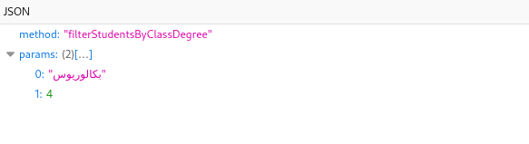
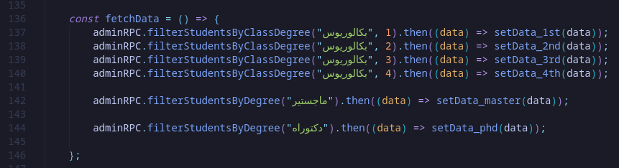
RPC: Remote Procedure Call
Calling backend functions from the frontend over REST API

Slide 25
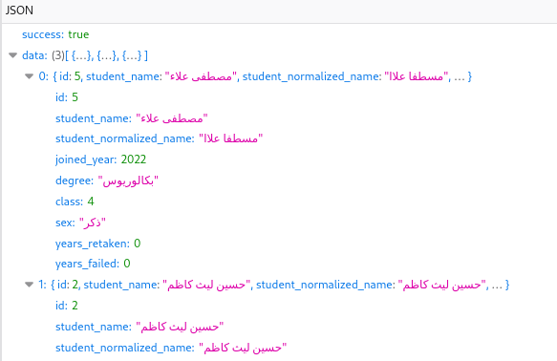
Remote Procedure Call Advantages
The backend recieves the RPC requests and if authenticated calls the RPC function
Can be used to call all kind of functions
Unify the REST-based API protocol and eliminates the need for defining a protocol for each protocol

Slide 26
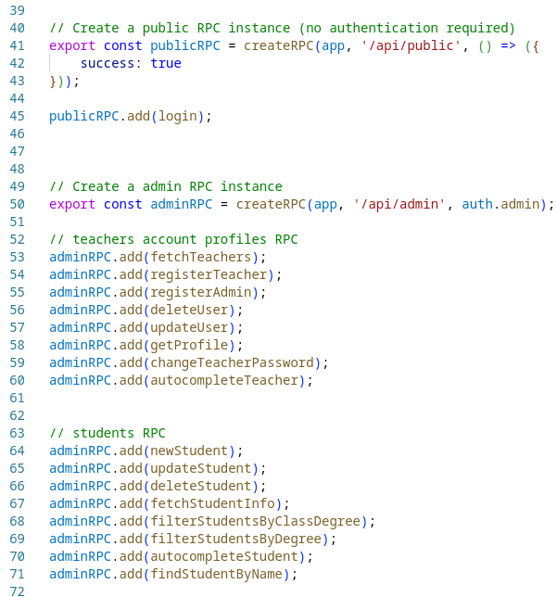
Role-based Authentication
JWT digital signature-based token based authentication
Teachers, Admins, Super Admins all are asigned different callback RPC functions so they can’t break access control

Slide 27


System requirements
Memory: 2 GB of RAM (recommended 4)
CPU/vCPUs: 1 core (recommended 2)
Diskspace: 8GB
Can be hosted any machine with on any machine with: 1. NodeJS 2. PostgreSQL 3. Express Framework for client: Web browser

Slide 28
Thank you for listening

